Slide 1
Credit Card
Analysis
By Manan Shah
Page
01

Slide 2

Company Background
Mastercard Incorporated is a global financial technology company headquartered in Purchase, New York, USA. Founded in 1966, it operates one of the world’s leading electronic payment networks, enabling secure, fast, and convenient transactions across more than 210 countries and territories.
It works closely with partner banks and fintech companies to innovate solutions around contactless payments, virtual cards, cross-border transfers, and fraud detection technologies. Through its “Mastercard Network,” it processes billions of transactions every year, ensuring efficient and secure authorization, clearing, and settlement.
Mastercard continues to play a pivotal role in shaping the future of digital payments. The company has also been investing heavily in AI-driven risk intelligence, cybersecurity, and sustainable finance, making it a trusted name in the global financial ecosystem.
Page
02

Slide 3

Problem Statement
In the rapidly evolving credit card industry, understanding customer behaviour and transaction patterns is critical for sustaining growth, reducing financial risk, and improving profitability. Financial institutions like Mastercard face challenges in tracking customer acquisition performance, spending habits, credit utilization, and delinquency trends across diverse customer segments. Without a centralized and interactive reporting system, important insights often remain hidden in raw data.
Page
03

Slide 4


Our Approach
Data Understanding and Cleaning: We first studied both the customer and transaction datasets to understand the meaning of each column and cleaned the data to remove any errors or unwanted values.
KPI and Filter Identification: We identified important KPIs like total transactions, total income, average utilization, and delinquency rate, and selected useful filters such as gender, education level, income group, and activation status.
Dashboard Design and Layout: We designed two dashboards — one for customer analysis and another for transaction analysis — using Power BI visuals like donut charts, bar graphs, pie charts, line graphs, and maps.
Drill-Downs and Interactivity: We added drill-down features to charts using hierarchy levels like year, quarter, and week, and used slicers to let users filter data easily and interact with the visuals.
Insight Extraction and Testing: Finally, we tested the dashboards with different filters to check performance and extracted meaningful insights related to spending habits, customer risk, and credit usage patterns.
Page
03

Slide 5
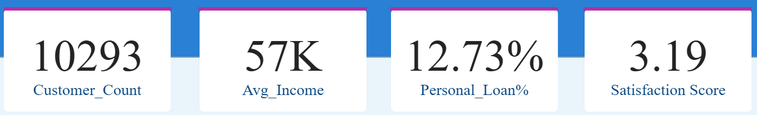
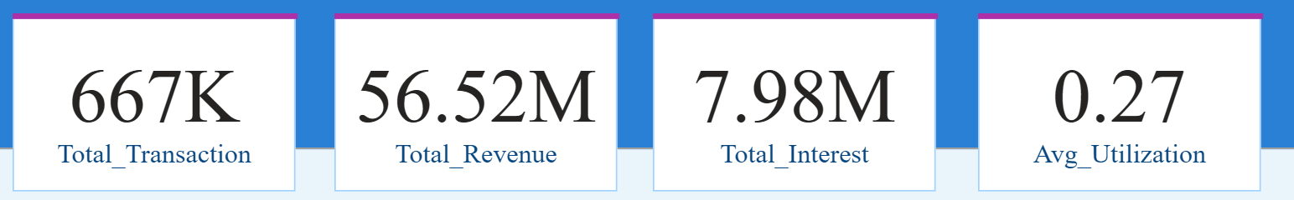
KPI’s
Key Performance Indicators
To understand the overall business in a glace, we have focused on this KPI's
Customer Dashboard KPIs:
Customer Count: The total number of customers in the dataset is 10,293.
Average Income: Average Income of customers turns around ₹57,000.
Personal Loan %: Around 12.73% of the customers have taken a personal loan.
Satisfaction Score:
The average satisfaction score is around 3 showing good satisfaction.
Transaction Dashboard KPIs:
Total Transactions: Customers have made a total of 667,000 transactions.
Total Interest: The total amount spent by customers across all transactions is ₹56.5 million.
Total Interest: The total interest earned from the customers across all transactions is ₹7.98 million.
Average Utilization: The average credit utilization ratio among all customers is 0.27.
Page
04

Slide 6
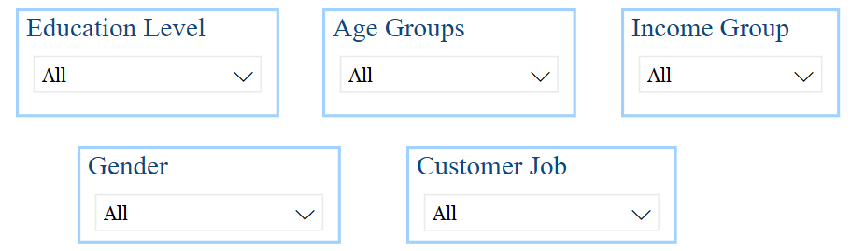
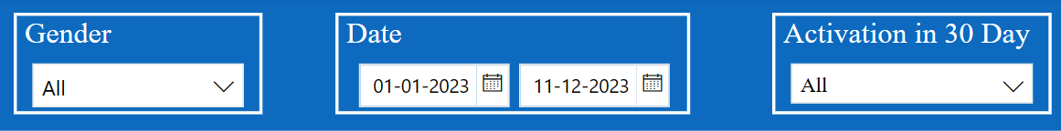
Filters
The dashboard provides following filters to refine the data
Customer Dashboard Filters
Gender: This filter allows the user to view data separately for male and female customers to understand how behavior differs based on gender.
Age Group: This filter groups customers into age ranges (like 18–25, 26–35, etc.) to analyze how different age groups spend, use credit, or take personal loans.
Income Group: Customers are divided into low, medium, and high income groups so we can compare their credit usage, loan status, and income-based trends.
Education Level: This filter helps us study how the level of education (such as undergraduate, graduate, or postgraduate) affects financial behavior.
Customer Job: This allows users to view data based on the customer’s job type (like self-employed, salaried, business) and see how profession relates to spending or delinquency.
Transaction Dashboard Filters
Gender: This filter lets users check transaction behavior separately for male and female customers to compare spending patterns.
Date (Week_Start_Date): This date filter allows users to select date ranges to analyze how transactions and credit use change over time.
Activation in 30 Days: This filter separates customers who activated their credit card within 30 days from those who did not, helping to analyze early engagement and behavior differences.
Page
05

Slide 7
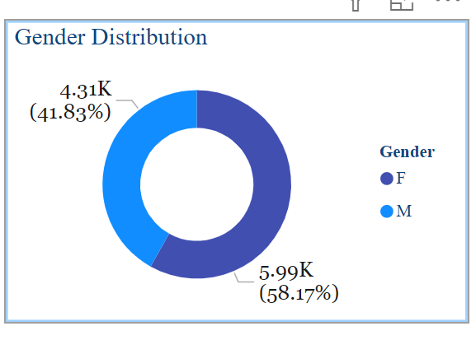
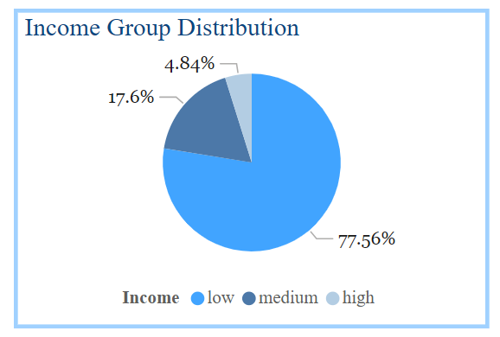
Key Insights
Gender Distribution
This chart shows the total number of male and female customers in the dataset.
From the chart, we can see that the number of female (59%) customers are more than male (41%) customers.
Income Group Distribution
This chart shows how customers are spread across different income groups — such as low, medium, and high income.
The chart reveals that the majority of customers fall under the low income group, while fewer customers belong to the high, and medium category.
Page
06

Slide 8
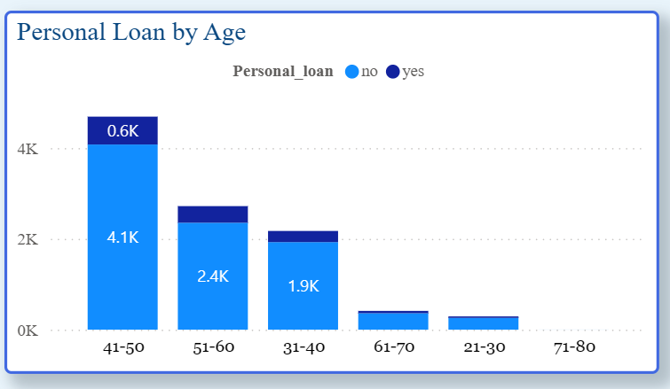
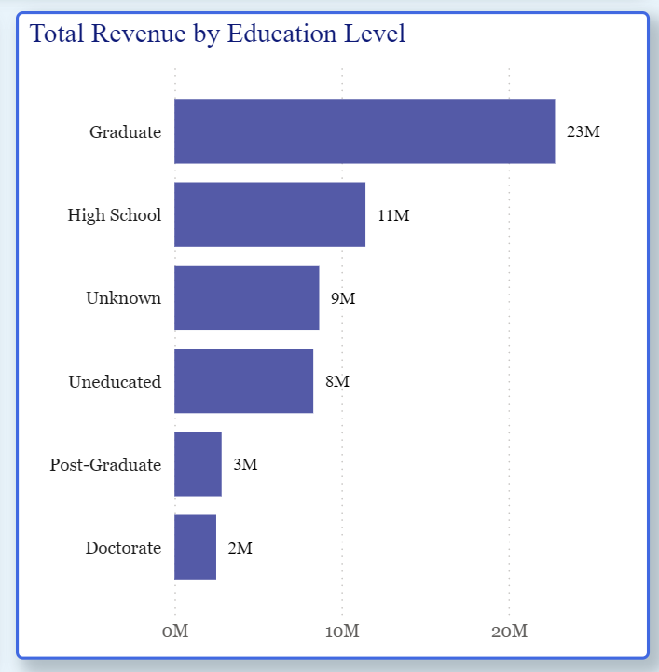
Personal Loan by Age
This shows the count of customers that has taken loan by age group.
It helps us identify which age group takes more personal loan, so more focus can be made on that age customers.
Total Revenue by Education Level
This chart shows the total revenue generated by customers based on their level of education.
This chart helps the business identify which customer segments based on education bring in more revenue. It can be useful for targeted marketing, credit card feature offerings, or educational-level-specific promotions.
Customers who are Graduates contribute the highest revenue at ₹23 million.
Page
07

Slide 9
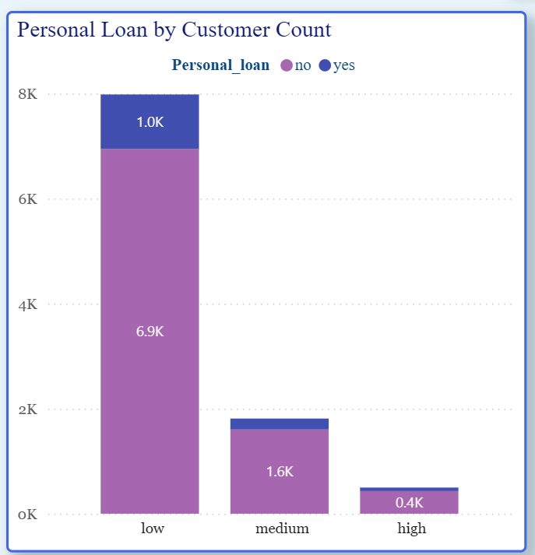
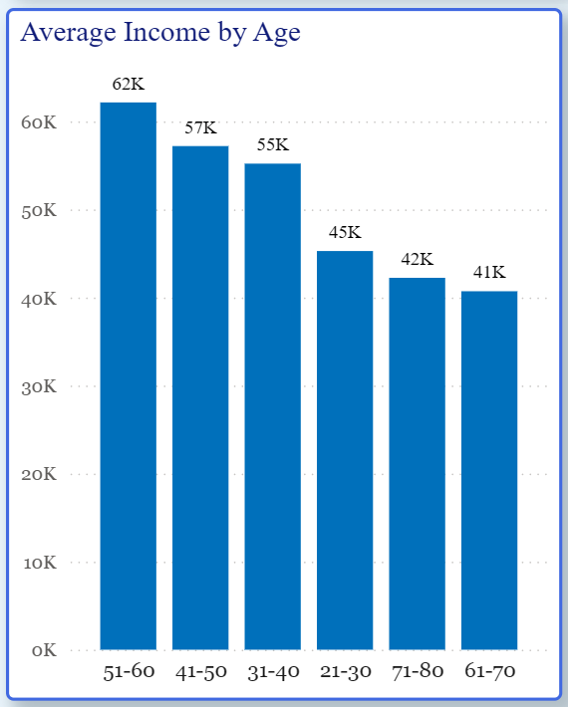
Personal Loan by Customer Count
This chart shows the number of customers in each income group who have or have not taken a personal loan. It helps analyze the relationship between income level and personal loan adoption.
The low-income group has the highest number of customers (≈ 7K), but only a small portion (≈ 1K) have taken personal loans.
Average Income by Age
This chart shows the average income of customers grouped by their age ranges. It helps to understand which age groups have higher or lower income levels.
The age group 51–60 has the highest average income at ₹62K, followed by 41–50 and 31–40. Income decreases in younger (21–30) and older groups (61–70, 71–80), indicating middle-aged customers are the highest earners in this dataset.
Page
06

Slide 10
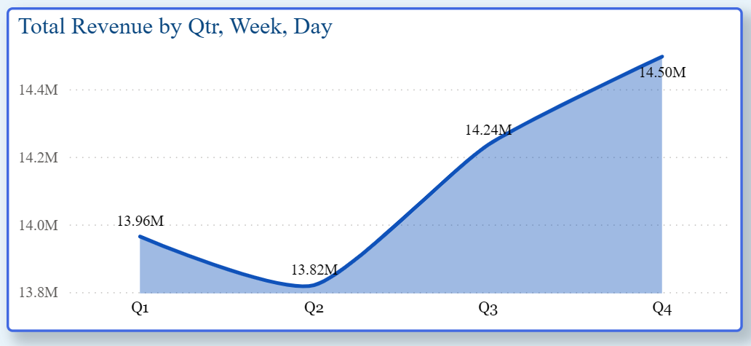
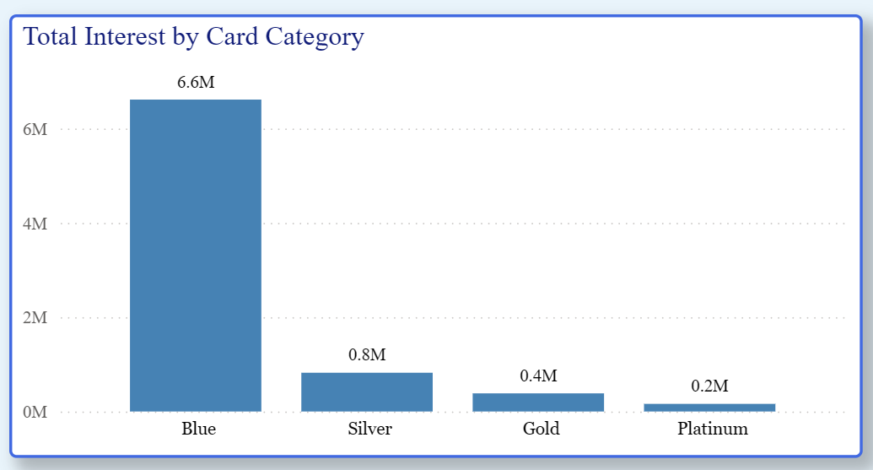
Total Revenue By Qtr, Week, Day
This shows how much customers generated revenue over time, starting from quarters, and lets you drill down to see weekly and spending patterns.
A hierarchy is provided Qtr -> Week -> Day to analyse the spending trends.
Spending is usually higher in Q4, week 27, and on Sundays.
Total Interest by Card Category
This chart shows the total interest amount earned from customers using different credit card categories such as Blue, Silver, Gold, and Platinum.
This chart helps the business understand which card categories are generating more interest revenue.
The Blue card generates the highest interest at ₹6.6 million, significantly more than any other category. Silver, Gold, and Platinum cards contribute far less.
Page
07

Slide 11
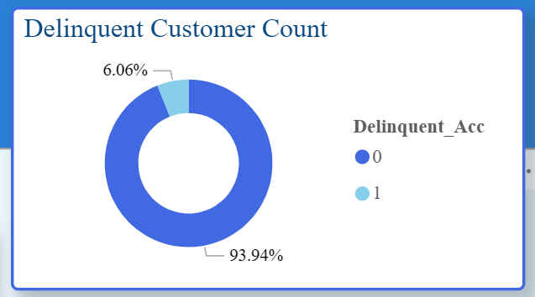
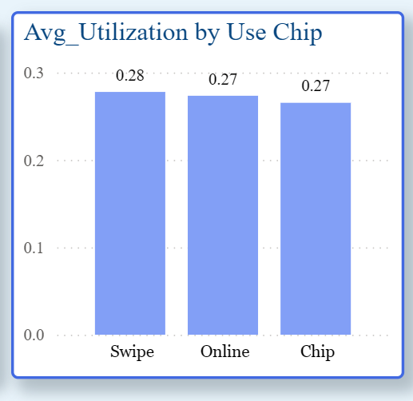
Delinquent Customers Count
This shows how many customers have been delinquent, meaning they have missed their credit payments.
It helps identify the portion of customers who are at financial risk, so the business can focus on improving recovery or offering support.
A small number of customers are delinquent, which is good, but they still need to be tracked.
Average Utilization by Use Chip
This shows the average credit utilization ratio based on the payment method used — Chip, Swipe, or Online.
Swipe and Online users generally have a higher credit utilization ratio, while Chip users tend to use less of their credit.
Page
07

Slide 12
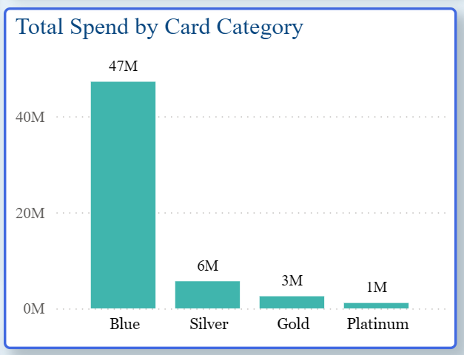
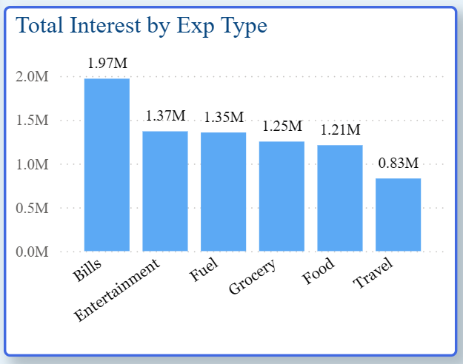
Total Revenue by Card Category
This shows how much total money was generated for company by different types of credit cards such as Blue, Silver, Gold, and Platinum.
Blue card users have the highest revenue generated, likely because most use this card type.
Total Interest by Exp Type
This show much interest is earned by the company through different expense types like Bills, Fuel, Grocery, Entertainment, Food, Travel.
Most interest earned is from Bills (1.97 million), followed by Entertainment and Fuel.
Page
06

Slide 13
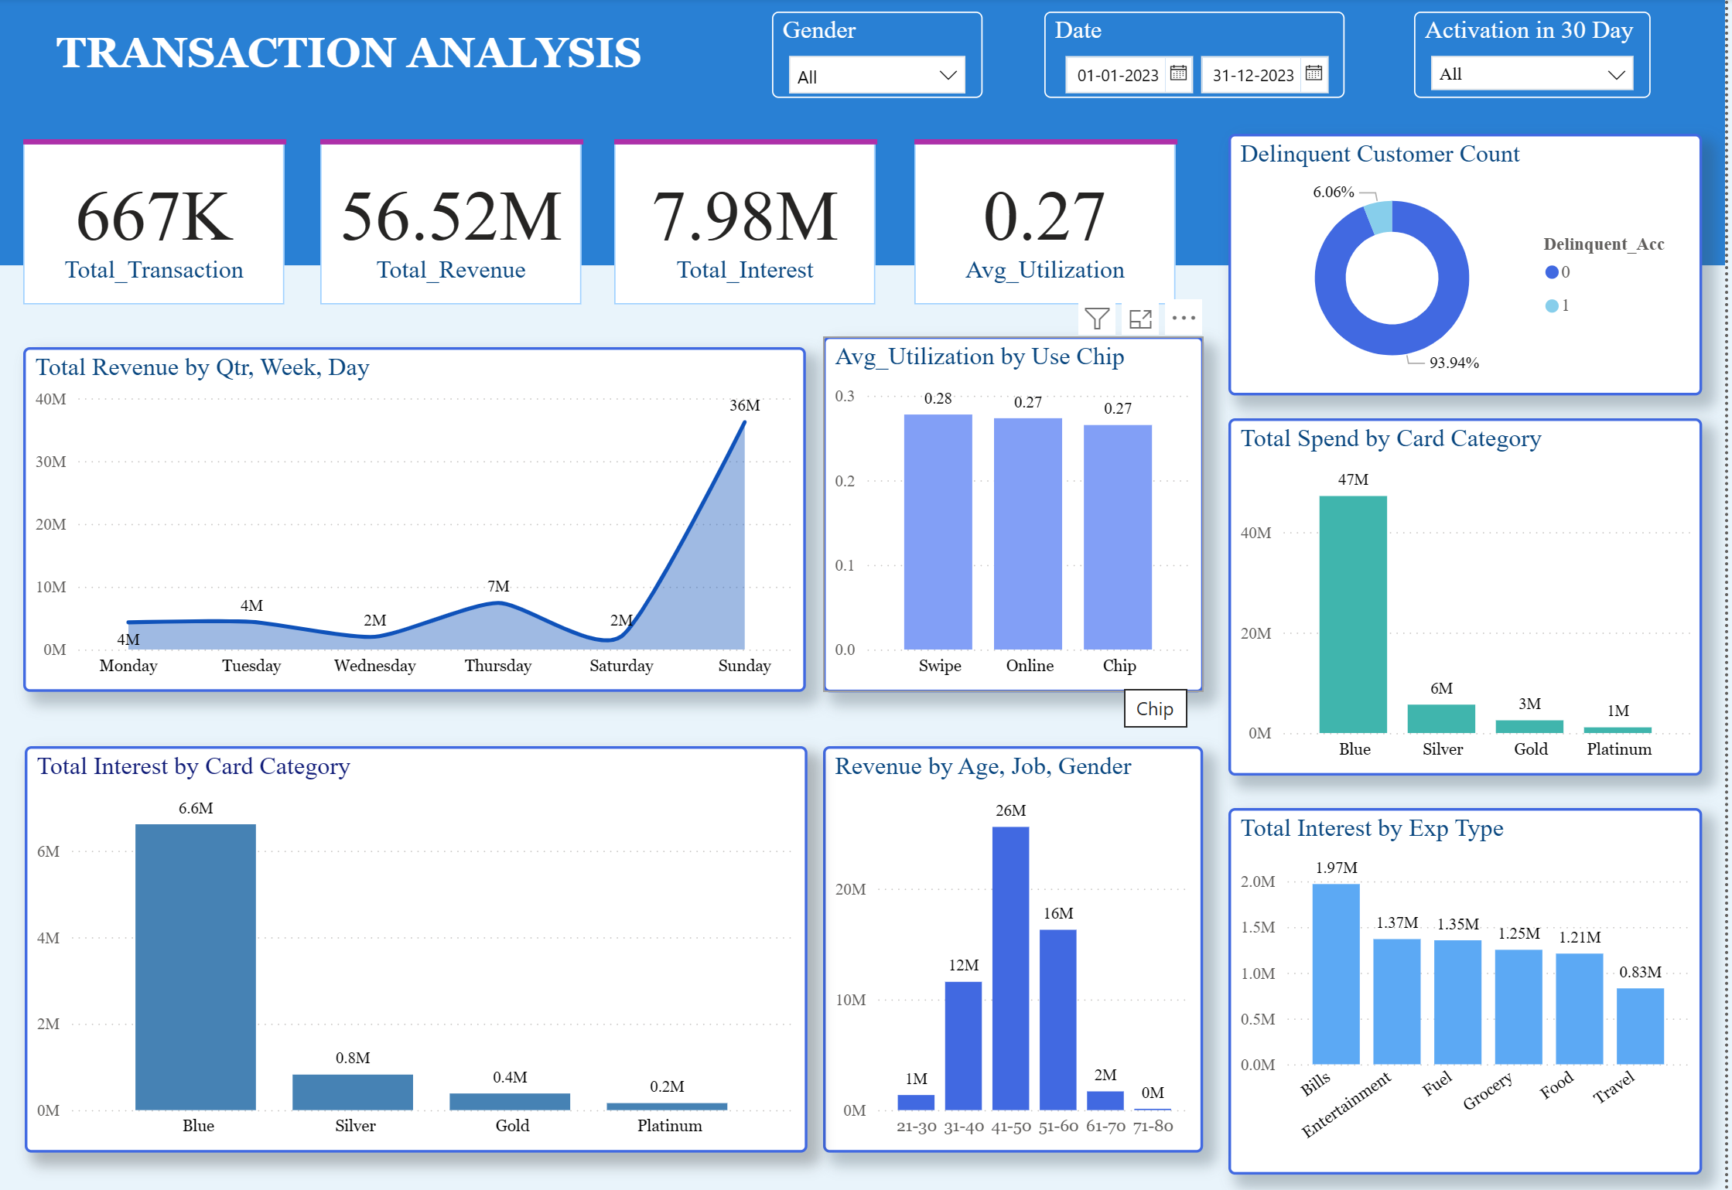
Dashboard Preview
Page
10

Slide 14
Conclusion
The number of male customers is slightly higher than female customers.
Statewise sales show that a few states contribute to the majority of total spending.
Most customers are either satisfied or highly satisfied, showing that the service quality is good.
Customers from the low income group with graduate education and age group 41-50 are more likely to take personal loans, especially those who are married.
Total spending increases at the beginning of each quarter and is highest on weekdays, Total Transaction also follows similar pattern.
Swipe and Online users have the highest average credit utilization.
Blue card users contribute the highest total spend, likely because most customers are using the Blue card.
Page
11

Slide 15
Thank
You.
Page
13

